Slide 1
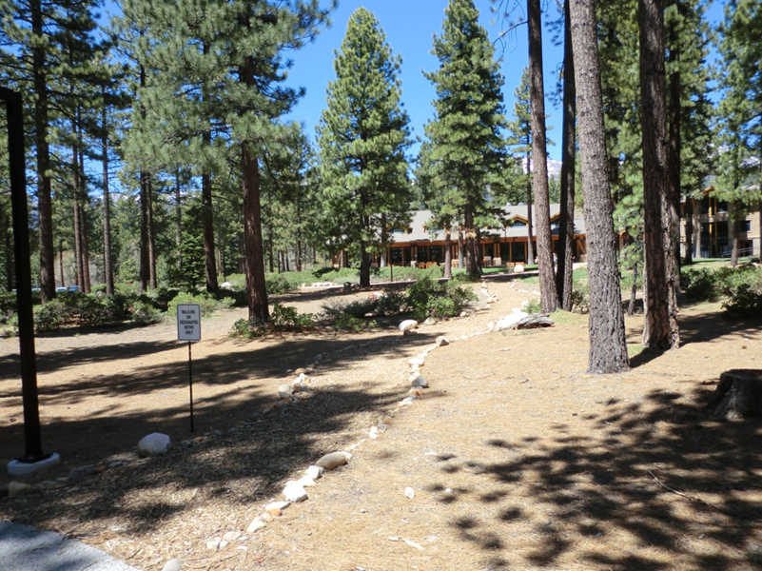
Washoe County Board of Adjustment
June 6, 2019
Administrative Permit Case Number WADMIN19-0009 Classical Tahoe

Slide 2
Case Description
To approve an Administrative Permit and outdoor community event business license application, and associated license conditions for Classical Tahoe, an outdoor concert event.
Held at the Sierra Nevada College in Incline Village, Nevada.
July 25, 26, 27, 28, 30, 31.
August 2, 3, 4, 6, 7, 9, 10, and 11.
Supplemental Movie Night will be held on August 4, 2019

Slide 3
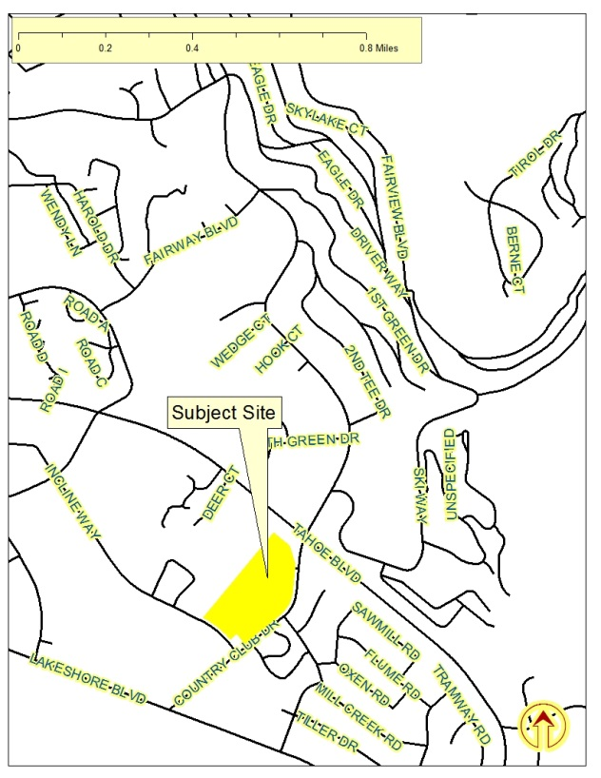
Vicinity
Map

Slide 4
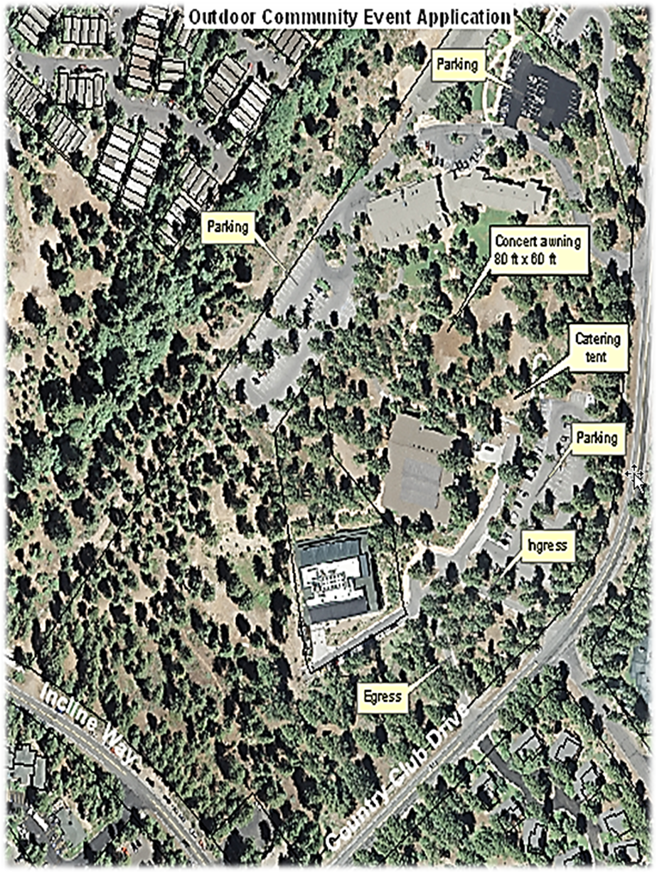
Site
Plan

Slide 5
Background
Concerts will be held between the hours of 5:00 p.m. and 9:00 p.m.
Unamplified classical music located within a portable tent erected on the College campus
Participant and spectator parking will be within the College campus with additional off-site (overflow) parking at the Incline Village General Improvement District (IVGID) Recreation Facility
Movie Nights on August 4, between the hours of 7:30 p.m. and 10:00 p.m.

Slide 6
Background
Incline Spirits, Sunshine Deli and SNC Catering will provide food and beverage service for the event
Waste Management has been contracted out, and IVGID provides Classical Tahoe with two lockable trash containers
Restroom facilities located within the campus buildings

Slide 7
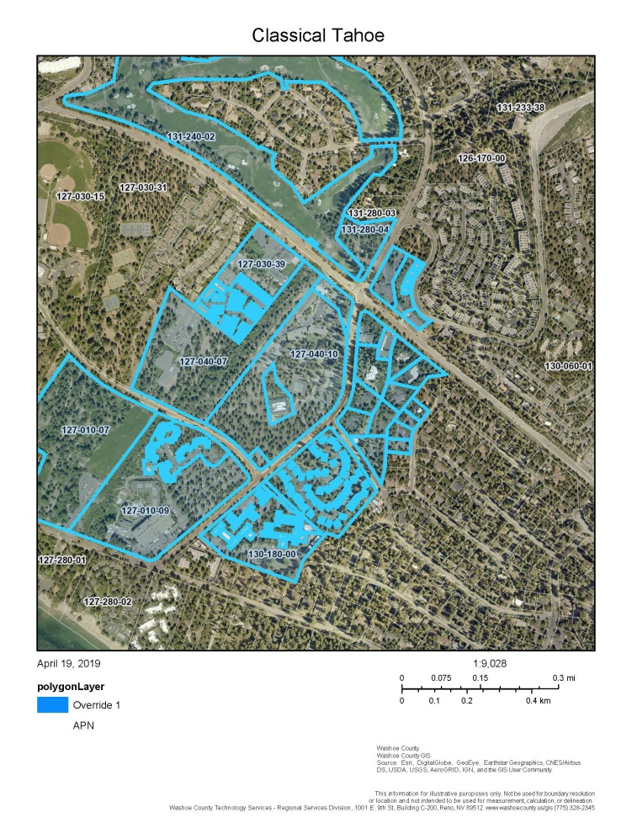
Notice

Slide 8
Recommendation
Those agencies which reviewed the application recommended conditions in support of approval of the project or provided no comments. Therefore, after a thorough analysis and review, Administrative Permit Case Number WADMIN19-0009 and the outdoor community event business license application is being recommended for approval with conditions.

Slide 9
Addendum to Conditions
Condition 1 (n)
  Clean Up: The applicant shall be responsible for total clean-up of the site. The site must be restored back to its pre-festival condition no later than August 27, 2019. The applicant shall contact the Washoe County Planning and Building Division to arrange final site inspection after clean-up is complete.

Slide 10
Possible Motion
I move that, after giving reasoned consideration to the information contained in the staff report and information received during the public hearing, the Board of Adjustment approve Administrative Permit Case Number WADMIN19-0009 and the outdoor community event business license application for Classical Tahoe, with the business license conditions included at Exhibit A for this matter, having made all relevant findings in accordance with Washoe County Code Section 110.808.25. I further move to authorize the Director of the Planning and Development Division, Community Services Department to issue the outdoor community event business license when all pre-event conditions have been met.

